Slide 1
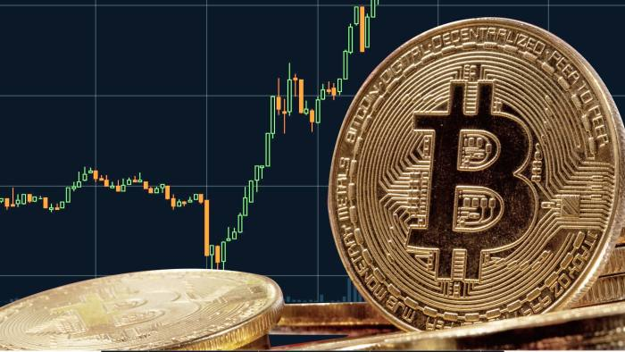
Intro To Bitcoin
Bali Bitcoin Meetup Marvin F. L. Hansen
Notes:
Link to download slides: https://ufile.io/mnkta

Slide 2
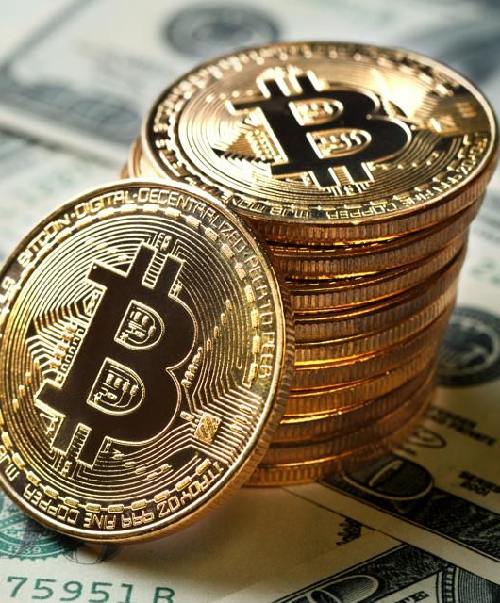
Overview
Money:
Intro to Money system
Intro to Fiat & Commodity Currencies
Crypto
Intro to Crypto Currencies
Intro to Bitcoin & ETH
NFT
Intro to Art Market
Intro to NFT (Non-Fungible Tokens)

Slide 3
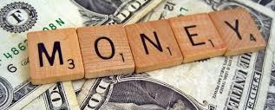

Slide 4
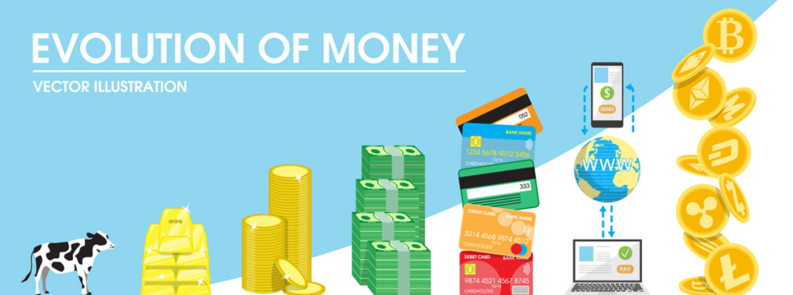
Evolution of Money
Notes:
https://www.publish0x.com/cryptosorted/the-origin-history-and-evolution-of-money-the-transition-to-xyjkkg

Slide 5
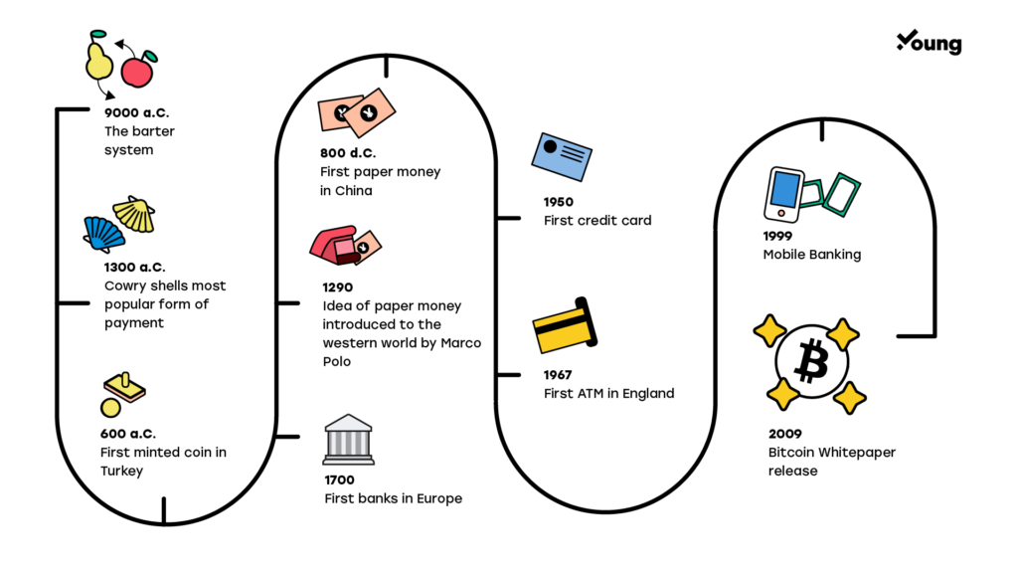

Slide 6
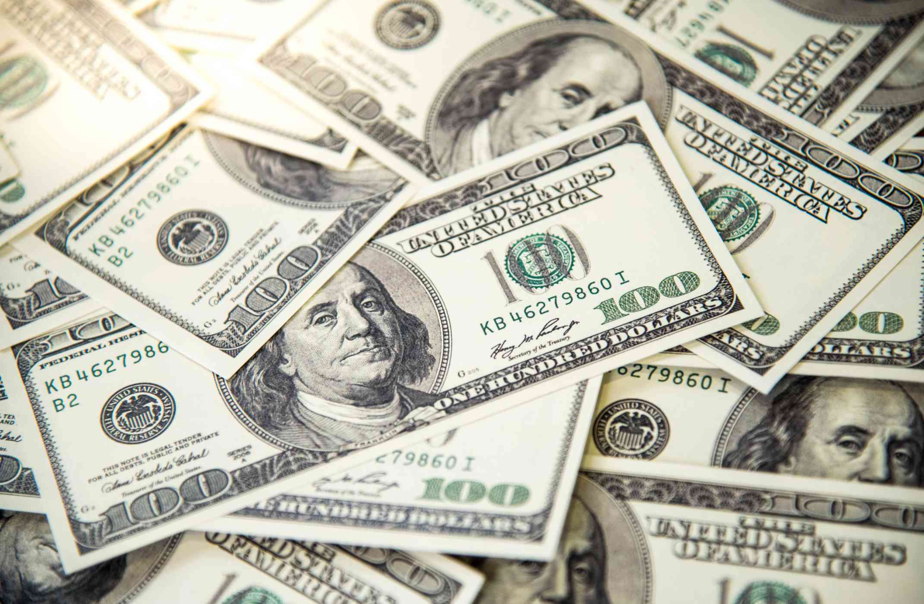
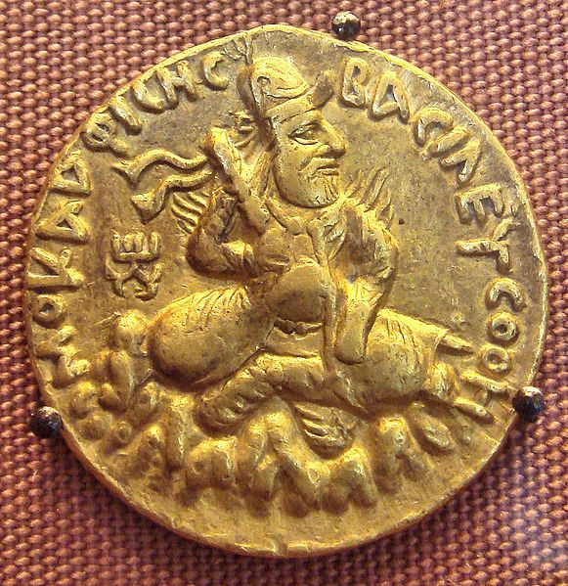
Two kinds of money
Commodity Money
Fiat Money
Money whose value comes from a commodity of which it is made!
Intrinsic value
Rare: hard to mine, or very difficult to acquire
Worth what people agree to pay!
Examples:
Gold coins
Rare spices
Silk, Jade etc.
Money created by Government through a legal degree
Zero intrinsic value
Gov. just prints it as needed
Worth what people believe its worth measured by the economic strength of the issuing country
Notes:
https://www.powercoin.it/en/cit-coin-invest-ag/5439-inca-sun-god-1-oz-silver-coin-5-palau-2021.html?gclid=EAIaIQobChMIkYexucK28AIVjhBgCh1UIAH-EAQYAyABEgIz1_D_BwE

Slide 7

Commodity Money Problem
Don’t necessarily have the means to buy Gold…
Can’t mine more Gold than what’s in the Ground
Estimated $400 million Gold produced per year and that’s it.
Can’t get more than what’s available!
Need more, pay more, a lot more…
Gold more valuable and expensive in hard times

Slide 8
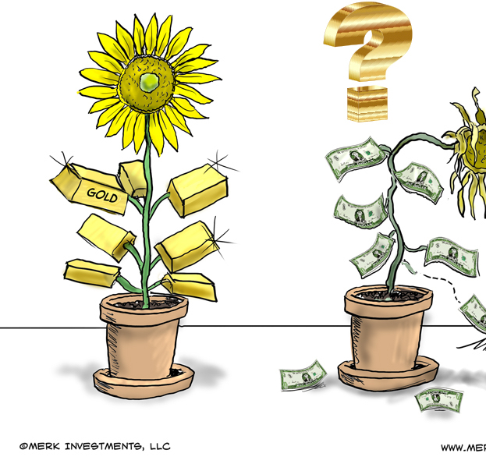
Fiat Money Problem
Printing too much money makes less valuable (inflation)
Not backed by anything else than public trust in the Government. Brexit & GBP....
Foreign Exchange Rates (Forex) swing widely during turmoil. Turkey & Lira…
Cash a lot less valuable than Gold!
Notes:
https://forum.vite.net/topic/2677/3-fiat-currencies-that-were-more-volatile-than-bitcoin-in-2019

Slide 9
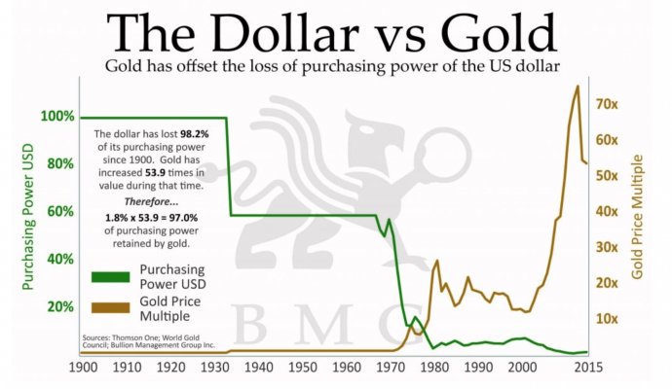

Slide 10
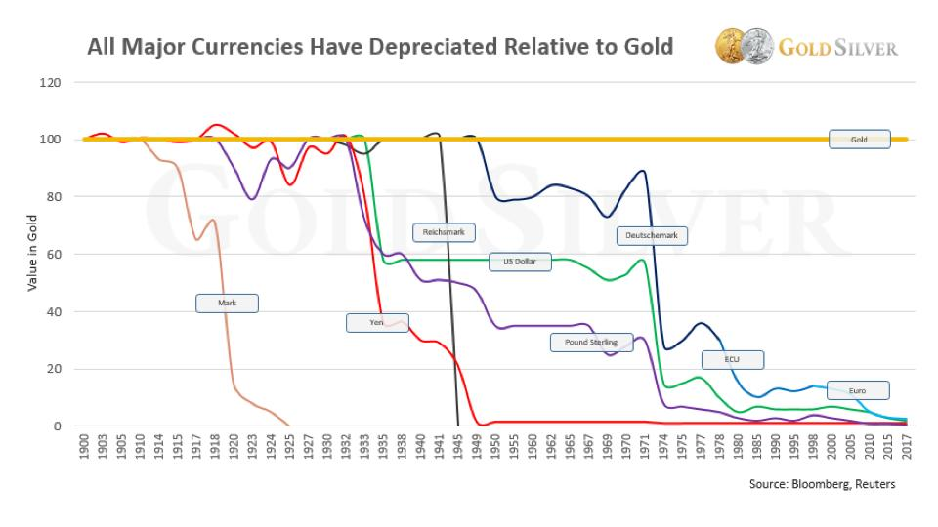
Notes:
https://www.gold-eagle.com/article/will-gold-replace-us-dollar-2020

Slide 11


Slide 12
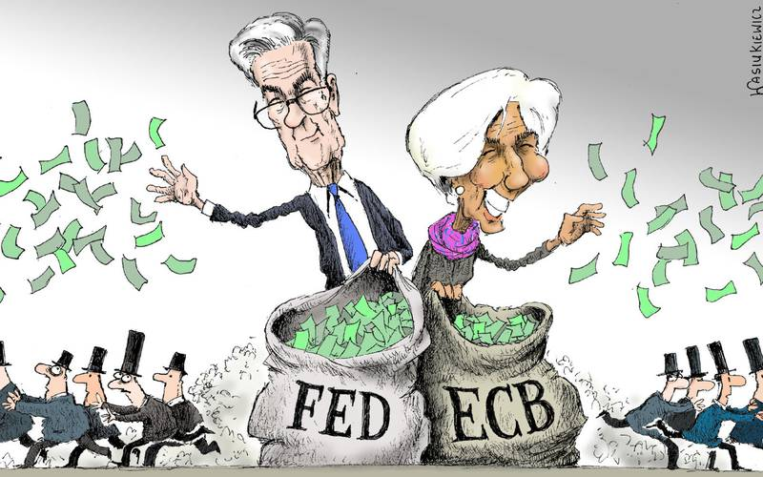
More Money, Less Value

Slide 13
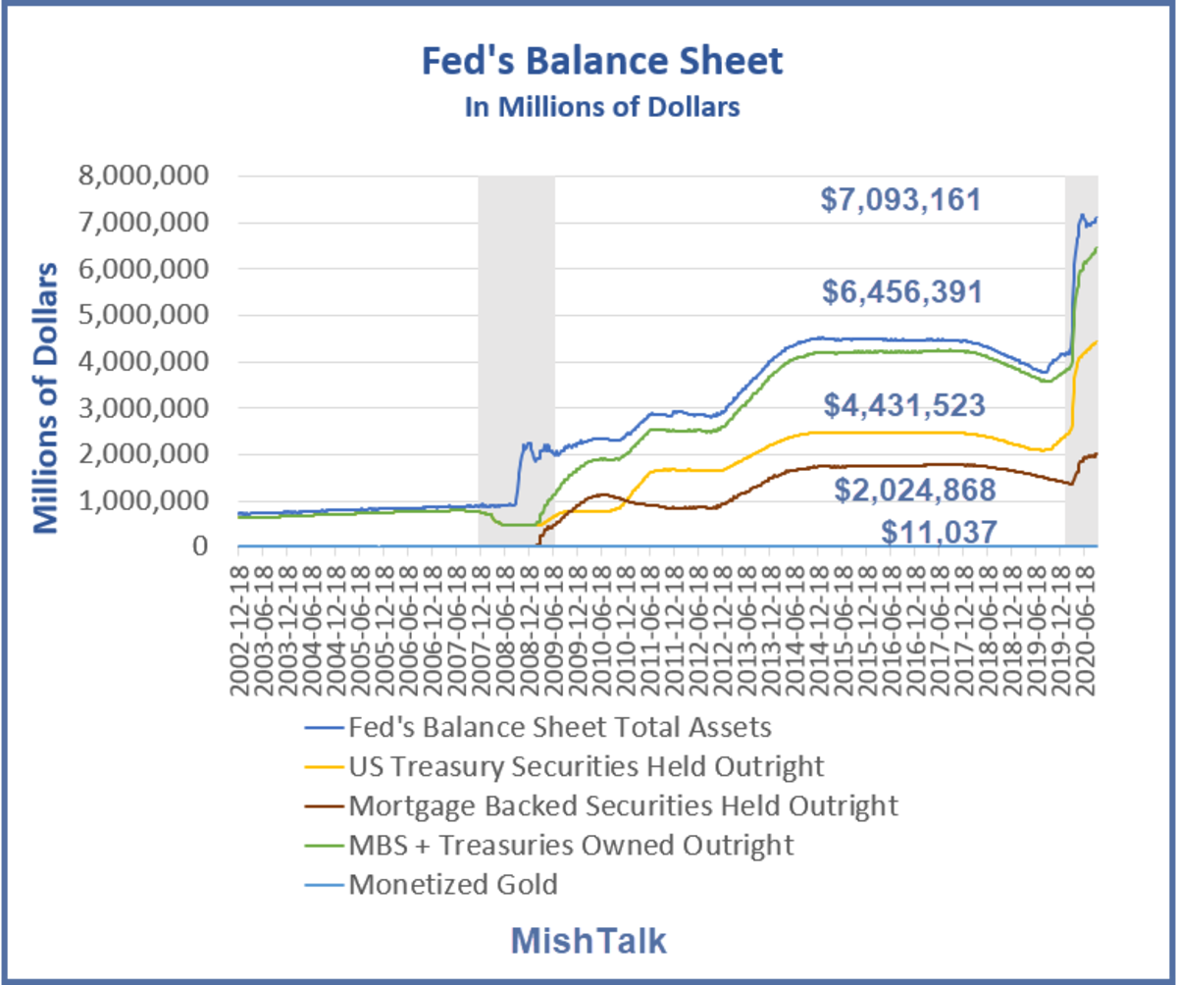
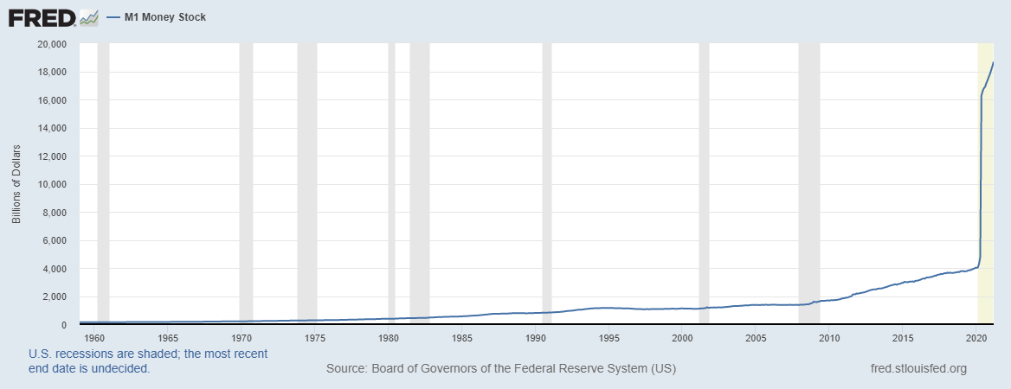
How Much More Money….
Notes:
Let’s zoom in

Slide 14
…. 6 Trillion More $ in 2020!
Notes:
Let’s zoom in

Slide 15

“ In any case, it seems that the modification of Regulation D in late April [2020] has effectively rendered savings accounts almost indistinguishable from checking accounts…”
Federal Reserve Bank of St. Louis
Notes:
What’s behind the recent surge in the M1 money supply?
https://fredblog.stlouisfed.org/2021/01/whats-behind-the-recent-surge-in-the-m1-money-supply/
What's Behind the Surge in M1 Money Supply?
https://mishtalk.com/economics/whats-behind-the-surge-in-m1-money-supply

Slide 16


Summary
More money printed than ever in the history of mankind
Money loses more and more value
No saving possible because interest rates are about zero
The Fed, essentially, destroys the value of your hard-earned cash!

Slide 17
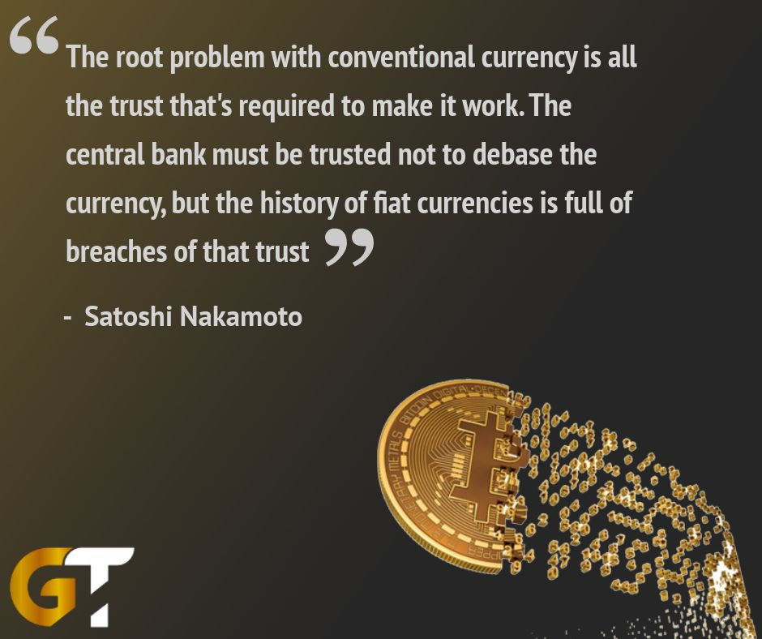
Notes:
https://twitter.com/goldtelegraph_/status/986715688717901824

Slide 18
Crypto Currencies

Slide 19
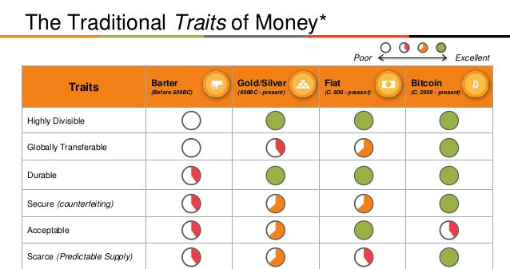

Slide 20
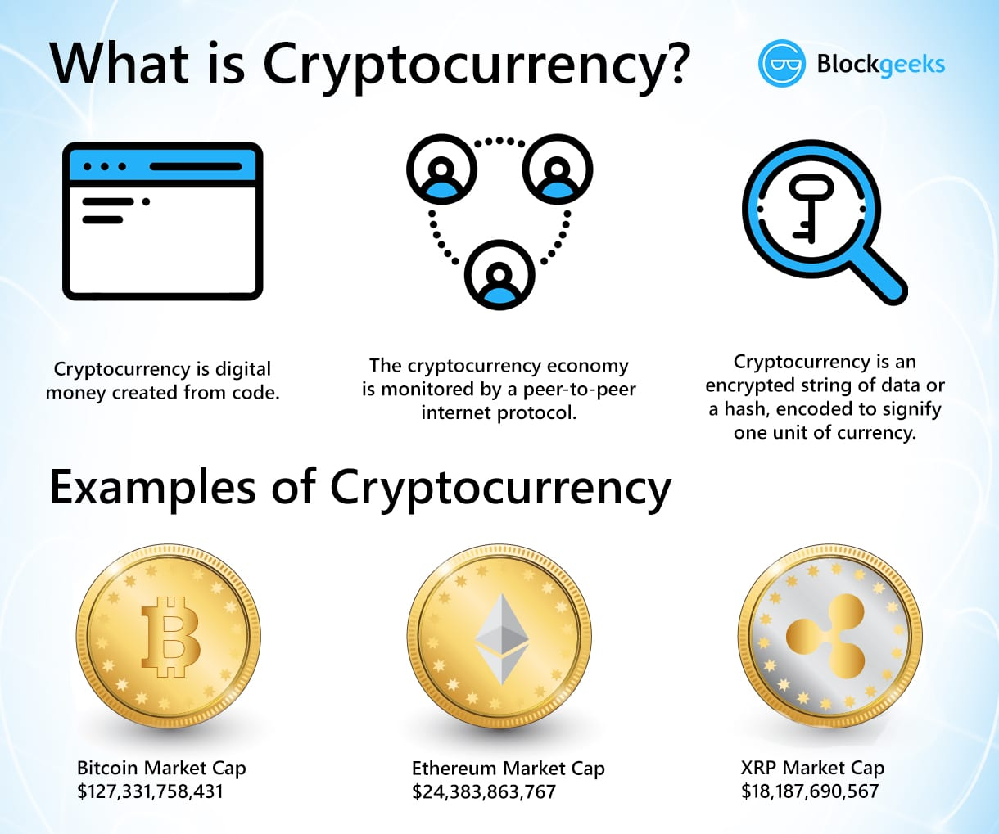

Slide 21
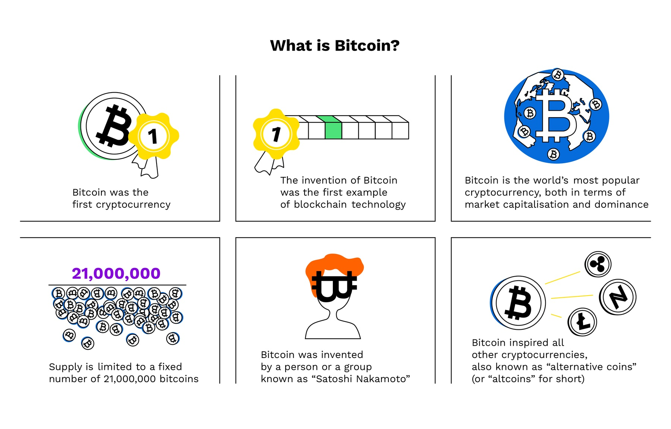

Slide 22
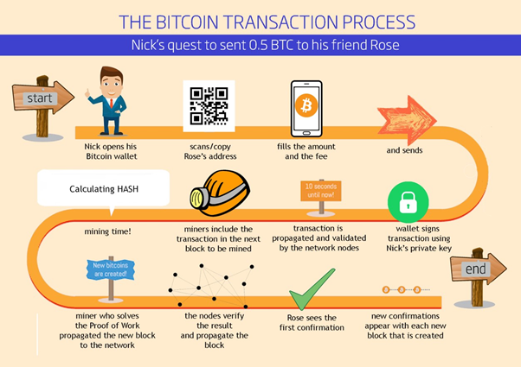

Slide 23
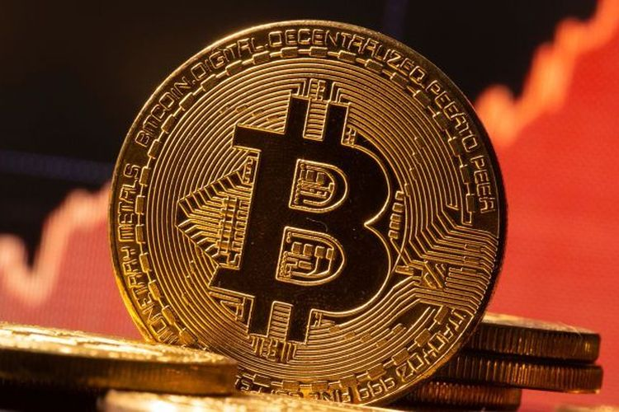
Bitcoin: Commodity or Fiat Money?

Slide 24
Bitcoin:
Made of crypto hashes
Rare: Only 20 million in total
Very hard to mine
People agree to pay a lot for 1 BTC
Commodity Money!

Slide 25
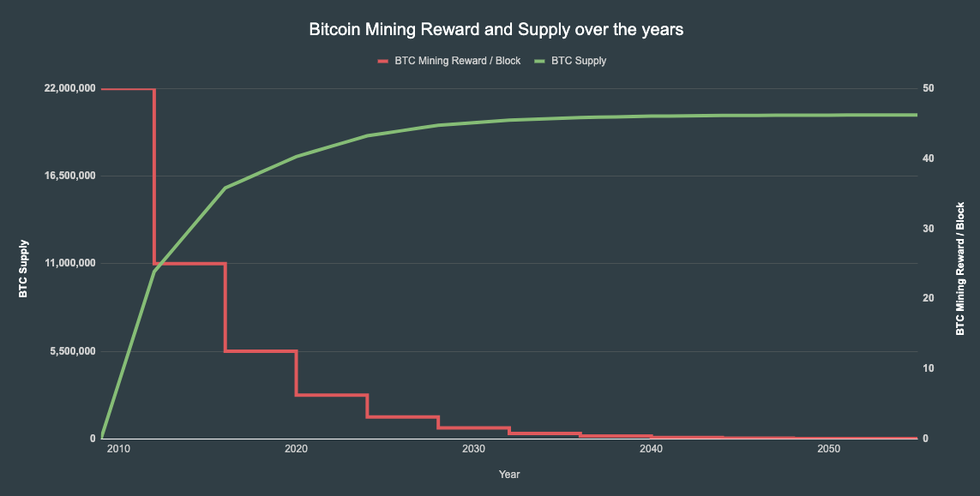

Slide 26
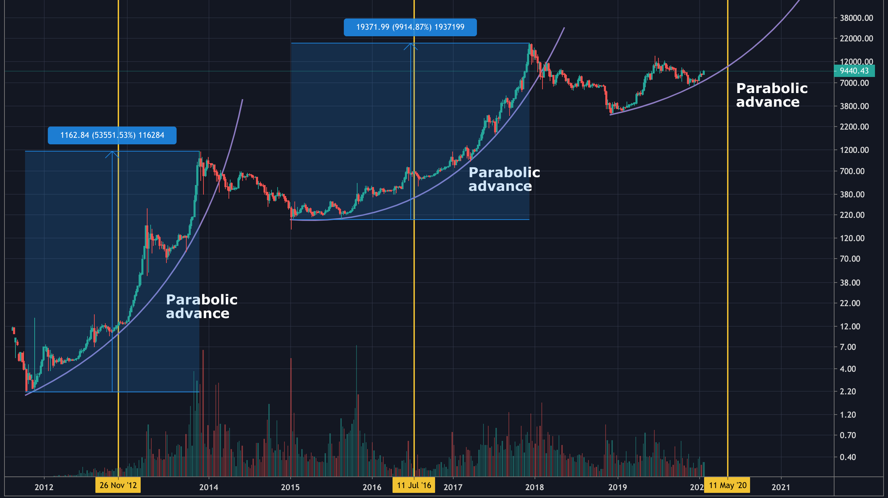

Slide 27
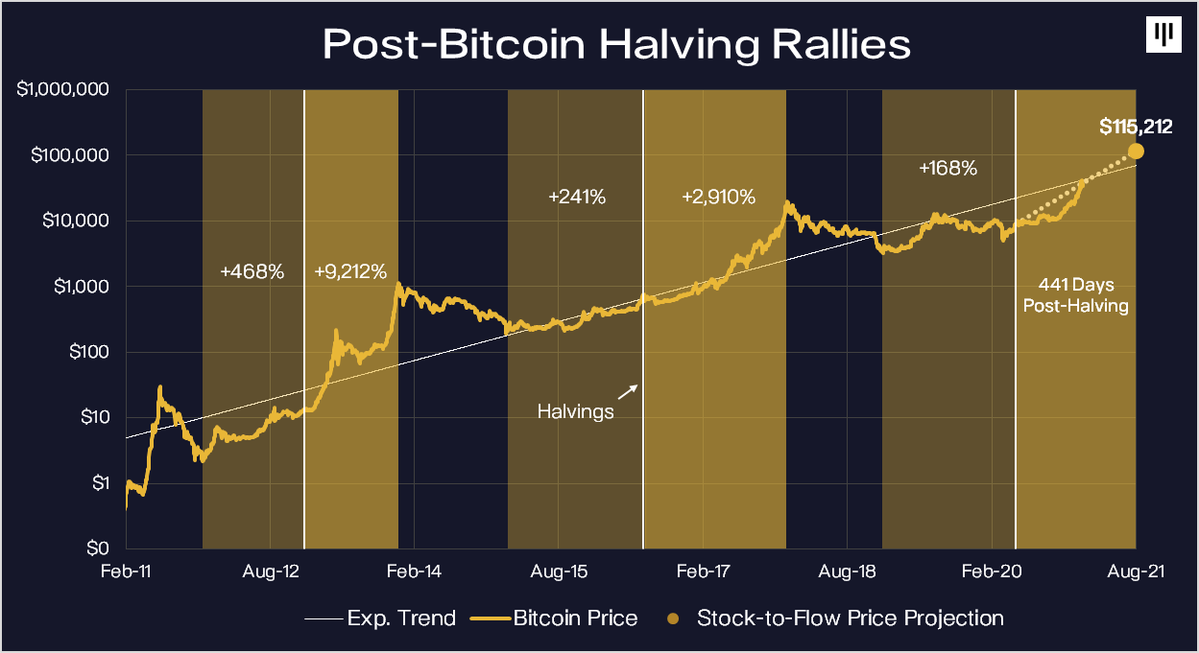

Slide 28
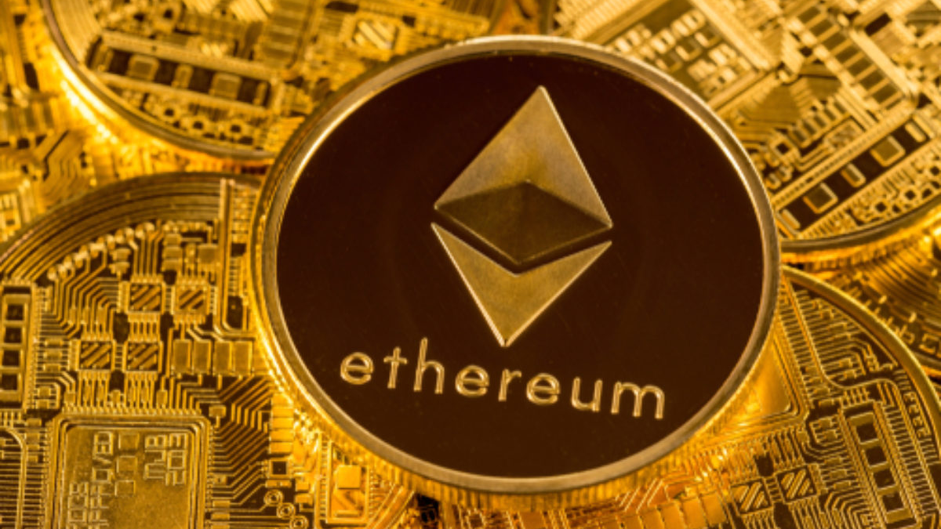
ETH Commodity or Fiat Money?

Slide 29
ETH:
Made of crypto hashes
Plenty: 120 million circulating and more
Not that hard to mine
People agree to pay a lot less for 1 ETH than, say, BTC
Fiat Money!

Slide 30

Why Crypto matter?

Slide 31


Slide 32



Slide 33


Slide 34
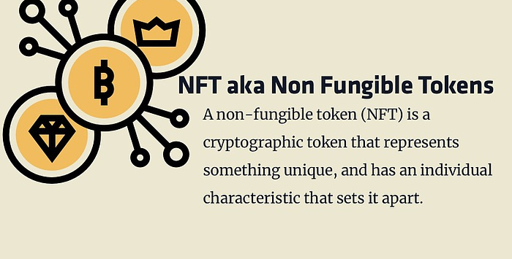

Slide 35
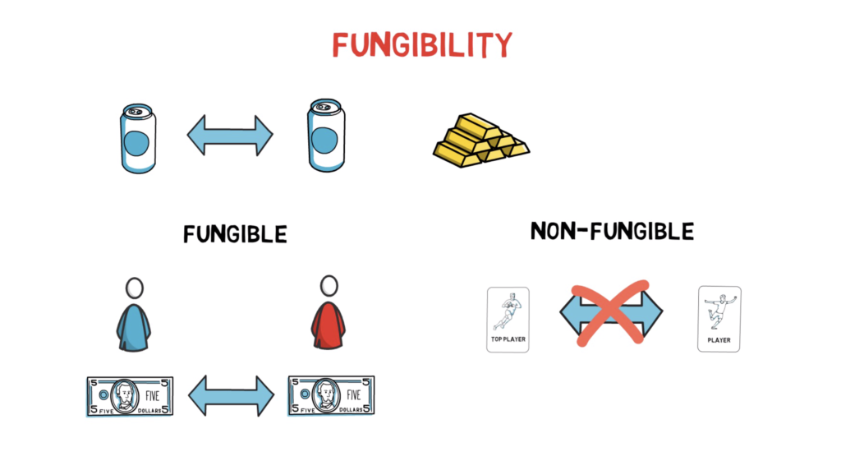

Slide 36
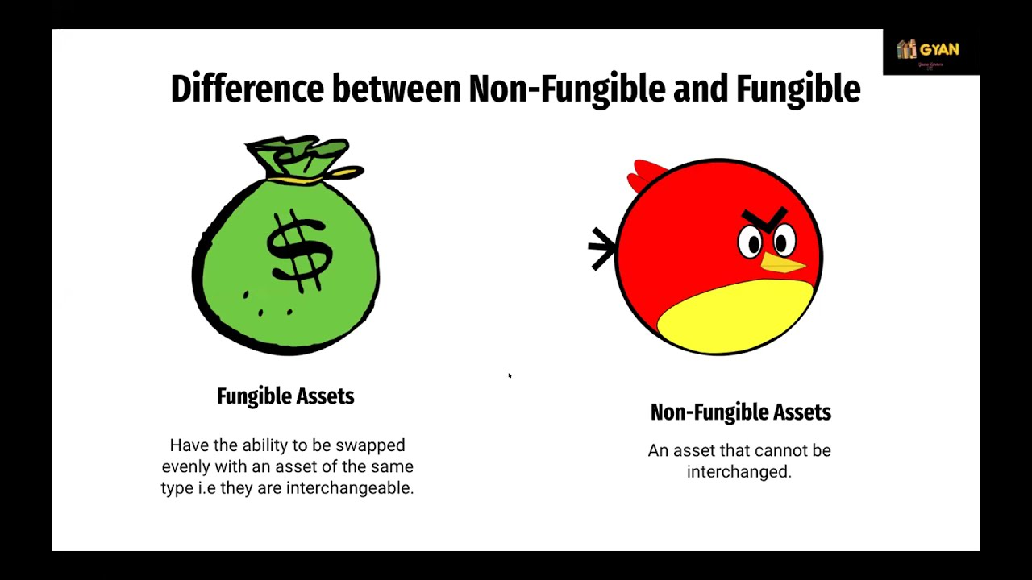

Slide 37

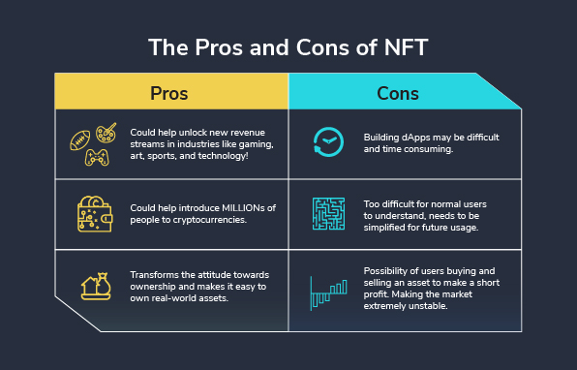

Slide 38


Q & A

Slide 39
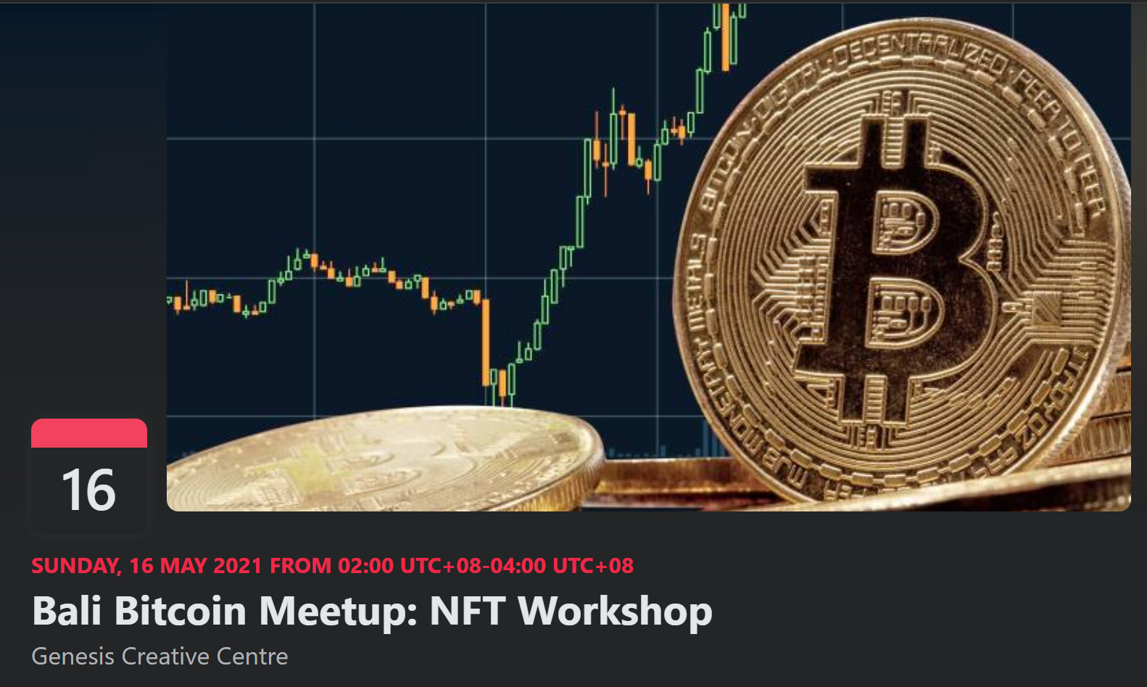

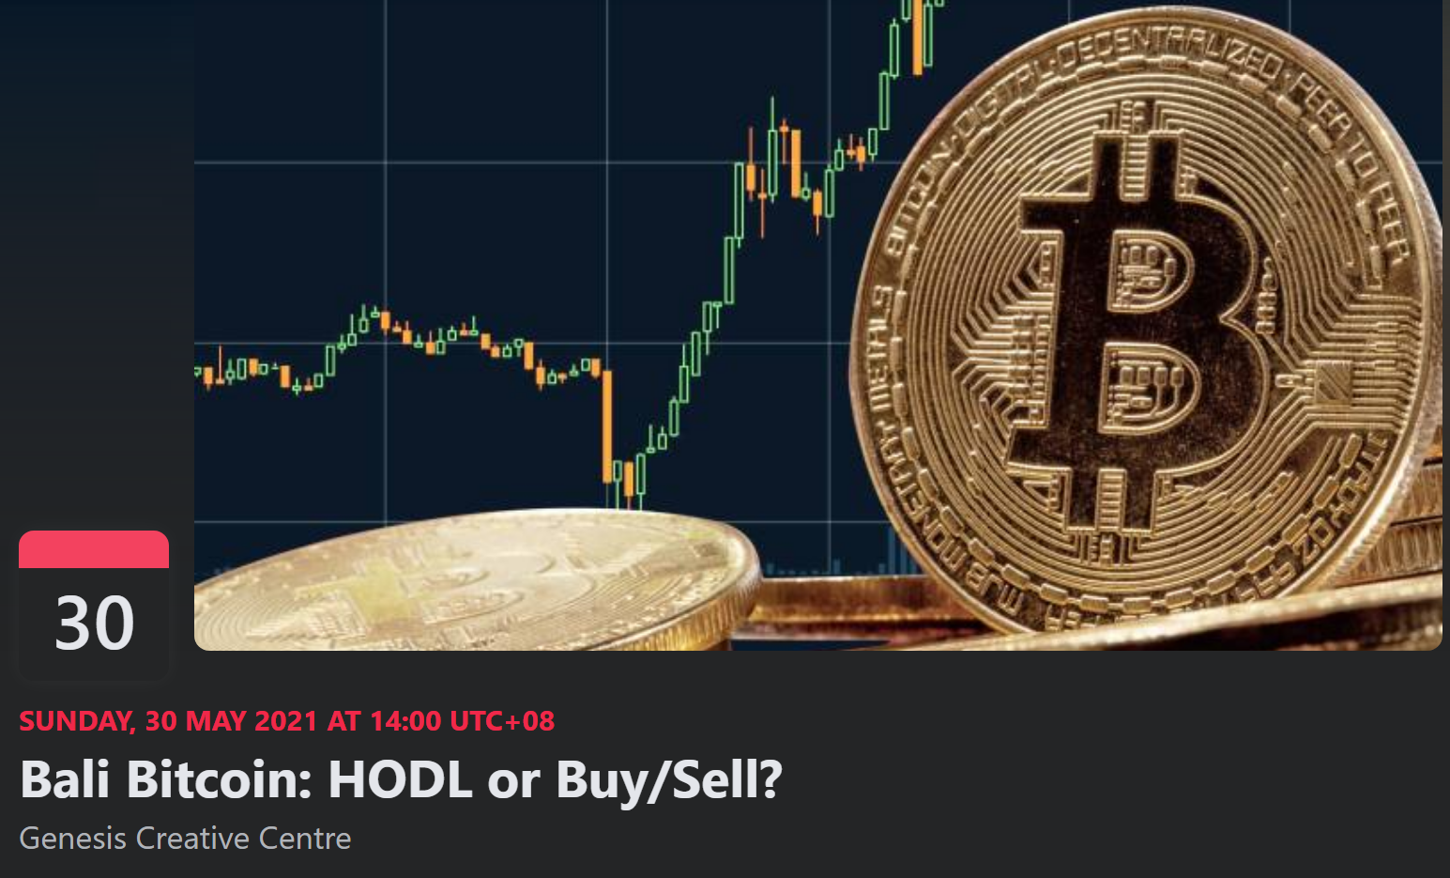

Next Events
May/16: NFT Workshop
May/30: Bitcoin HOLD or Buy/Sell
June… Stay Tuned!

Slide 40




Community
https://t.me/joinchat/2T6yvFcokRQ3ZDQ0
/ Bali Bitcoin

Slide 41


